Slide 1
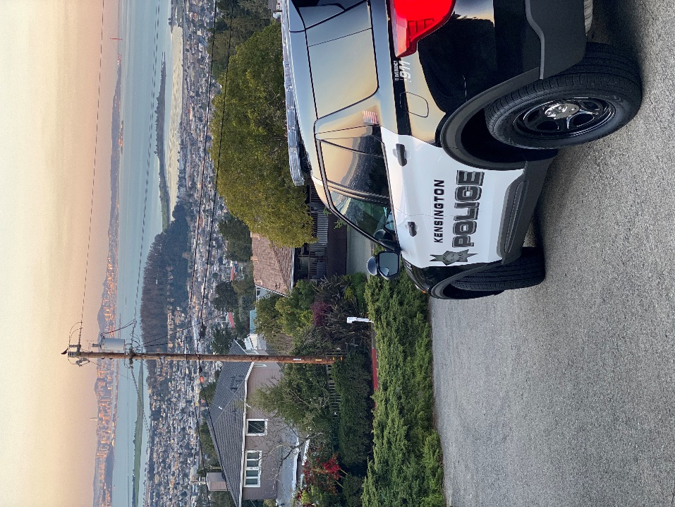


Kensington Police Department
2020 Annual Report
Kensington Police Protection and
Community Service District
Integrity, Empathy, Courage,
& Professionalism

Slide 2

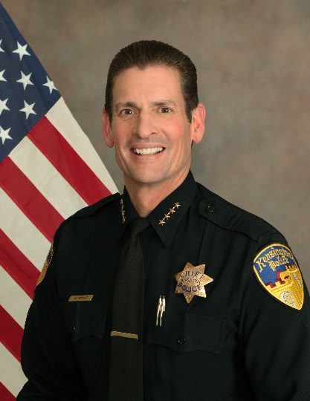

Message from the Chief
It is my pleasure to present to you the Kensington Police Department’s Annual Report for the calendar year 2020.
Kensington PD has gone through many challenges and positive changes this past year as we continue to improve the service to our community. The Police Department strives to maintain Kensington as one of the safest and best places to live in California. We do this by our new mission which requires us to be “Fully Engaged” in everything we do; from the day to day, to the life threatening. We focus those efforts on the Community, Quality Service, Crime Prevention, Traffic Safety, Quality of Life Issues, and Responsive Patrol Operations.
In the last half of this year, the police department became fully staffed for the first time in many years. We have also hired a Volunteer Reserve Officer and started our volunteer program with two volunteers in the hiring process. Once Covid-19 is behind us our Community Engagement Program will come into full swing with our Community Police Academy, Enhanced Volunteer Program, Coffee with a Cop, Community Meetings, and Problem-Solving sessions.
We have focused this year on improving the efficiency and quality of the police department through technology, policies and procedures, training, and positive community relations. This report gives a snapshot of KPD, its accomplishments, and its future goals and objectives.
We welcome feedback so please feel to contact us anytime.
Sincerely,
Walt Schuld
Interim Chief of Police

Slide 3

Mission Statement
“PUBLIC SAFETY REQUIRES US TO BE FULLY ENGAGED.”
The Kensington Police Department strives to be “fully engaged” in everything we do; from the day to day, to the life threatening. We focus our efforts and resources on several key areas:
Community,
Quality Service,
Crime Prevention,
Traffic Safety,
Quality of Life Issues, and
Responsive Patrol Operations.
Core Values
Integrity, Empathy, Courage, & Professionalism

Slide 4


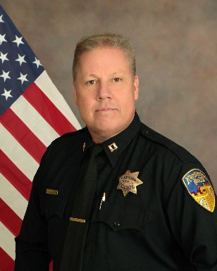
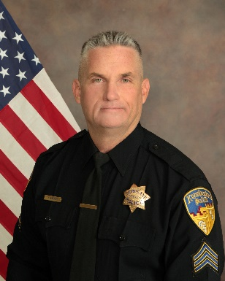
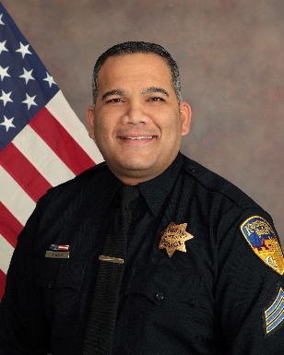
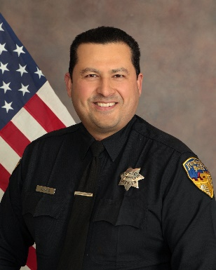
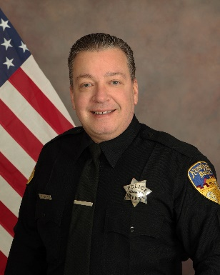
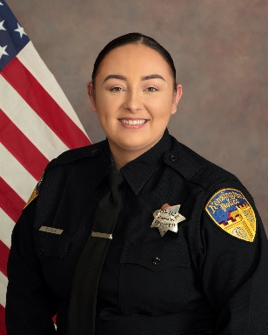
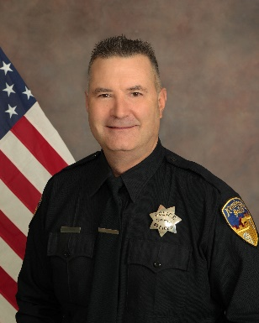
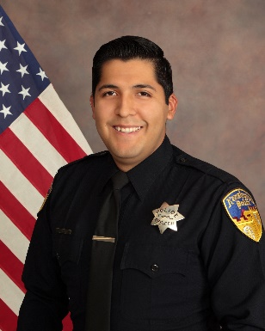
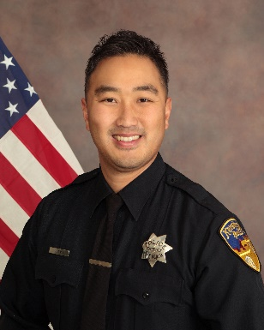
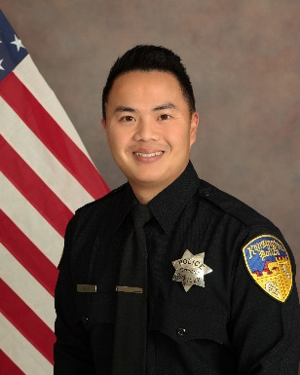
Members
Interim Chief Walt Schuld
Captain Mike Gancasz
Sergeant Keith Barrow
Detective Sergeant Amit Nath
Officer Juan Ramos
Officer Theodore Foley
Officer Tamiko Fodor
Officer Brad Harms
Officer Jose Fajardo
Officer Roy Bang
Reserve Officer Thang Ho

Slide 5
ACCOMPLISHMENTS
Designed and implemented a contemporary police patch and logo that is consistent with the KPPCSD brand and logo.
Upgraded computers.
Increased Traffic Safety Patrols.
Changed KPD’s reporting on Traffic Collisions to conform to SWITRS making the PD eligible for Traffic Grants.
Revised and updated entire policy manual (e.g., 50 policies).
Updated Field Training Manual and received certification from the California Police Officers Standards and Training (P.O.S.T.).
Implemented Traffic Warning Citations.
Revised and updated Department and Community forms.
Purchased and outfitted three new PD vehicles.
Improved graphics on new patrol cars.
Improved Evacuation Safety.
Implemented Body Worn Cameras.
Hosted more than twenty community/neighborhood meetings.
Received no formal citizen complaints and there have been no new lawsuits or legal fees.

Slide 6
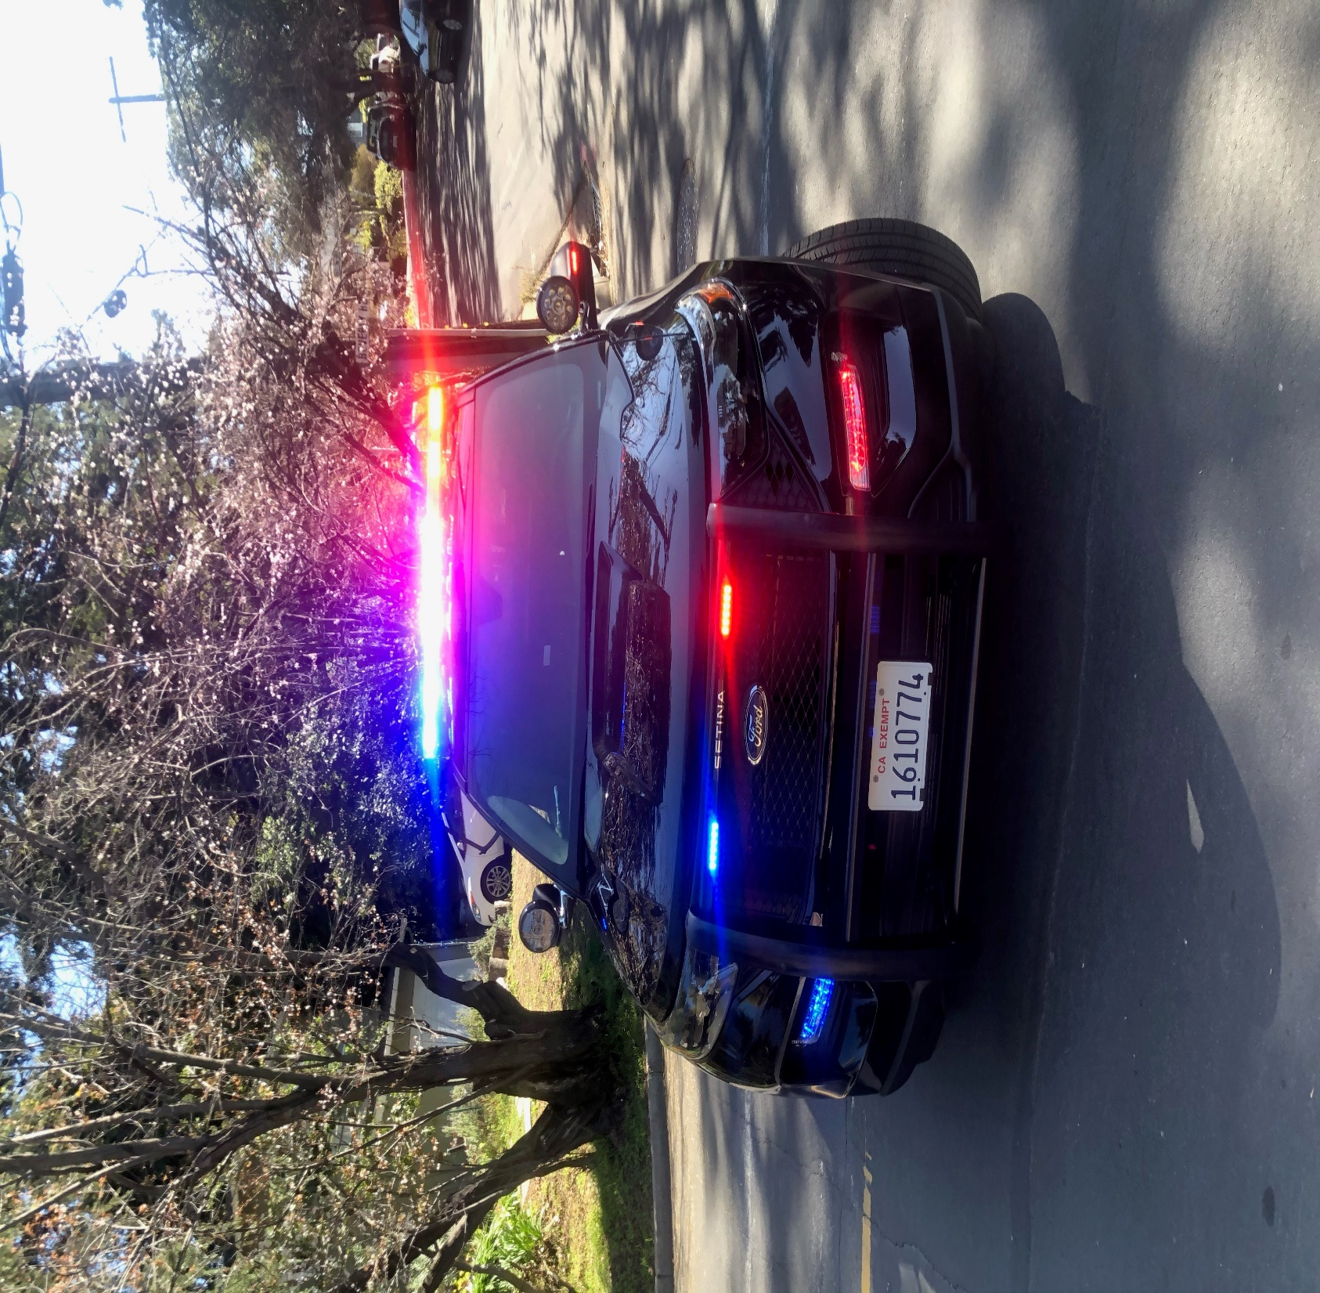
Crime Analysis and Crime View
The Kensington Police Department handled 9299 incidents, which is 43% higher than 2019 (6520 incidents). There has been a 164% increase in thefts compared to the previous year due to thefts from vehicles and of catalytic converters, as well as mail theft.

Slide 7
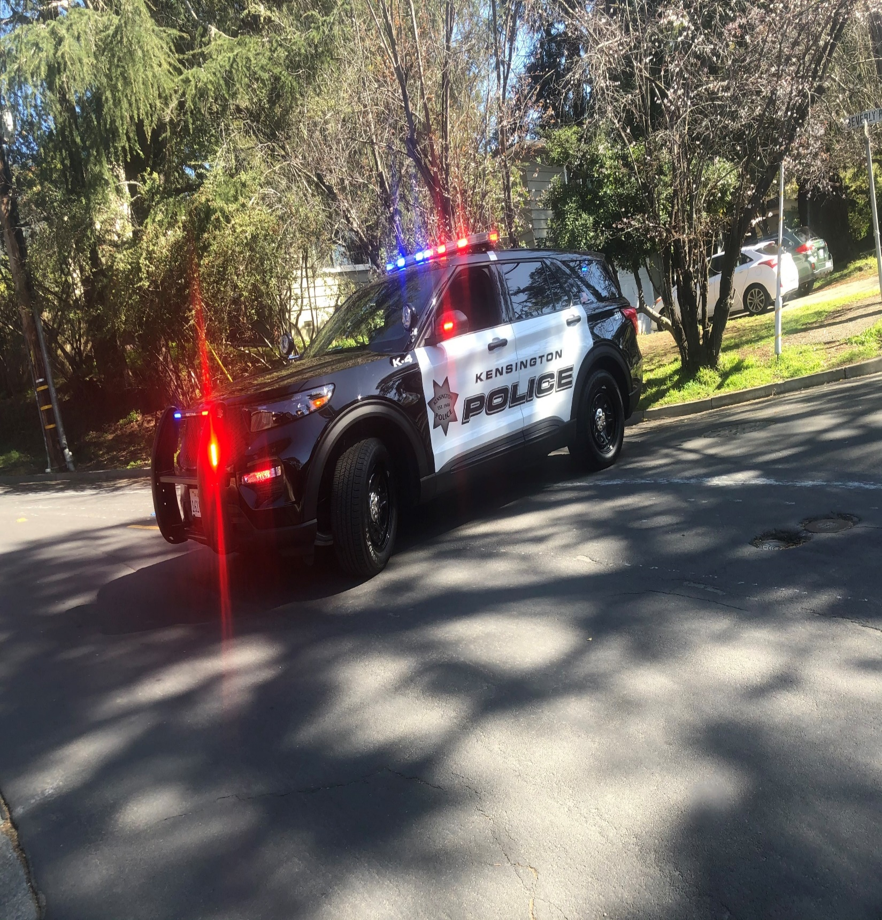

Slide 8

There was a slight increase in felony arrests from 2019. However, there was an overall decline in total arrests for 2020 versus 2019.

Slide 9
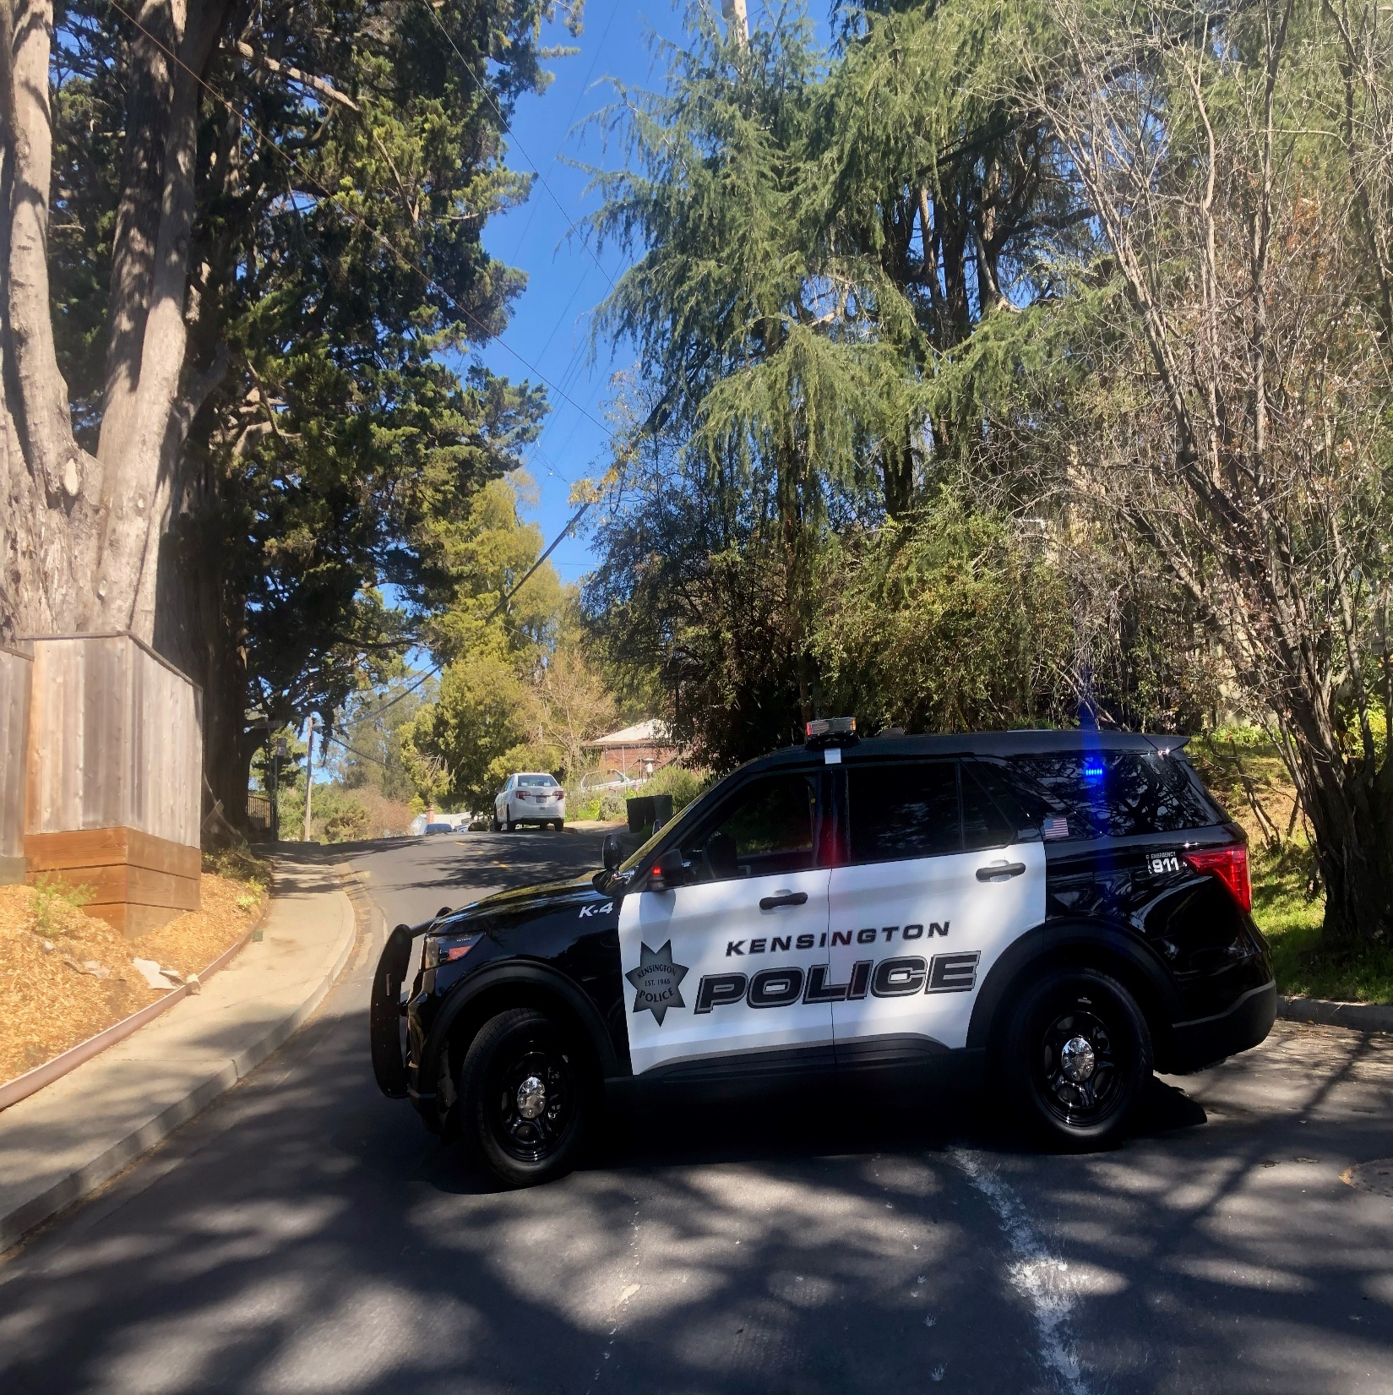
There has been a 44% decrease in traffic accidents compared to the previous year.
KPD officers have written a total of 319 traffic related citations compared to the previous year’s 150 citations.

Slide 10


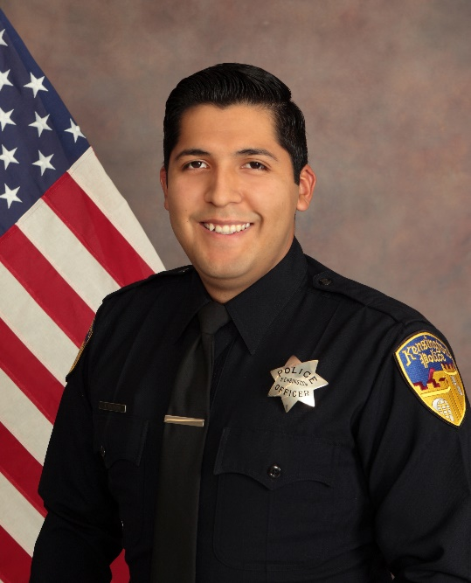
New Hires
Mike comes to Kensington PD with over 20 years of experience in law enforcement including experience as a Commander. He supervised numerous units including Youth Education & Services Unit, Code Enforcement Unit, Traffic Division, Detective Division, and Gang Unit. He is a decorated homicide detective and has participated in numerous multi-agency high profile cases. He has command level experience in the Patrol Division, Community Outreach Unit, Administration, Training, and Internal Affairs. He holds a Bachelor’s Degree in Criminal Justice Management and will be graduating with a Master’s Degree in Organizational Leadership in 2021. He is a graduate of the Sherman Block Supervisory Leadership Institute and will graduate from the POST Command College, Class 67 in 2021.
Captain
Mike Gancasz
Jose attended Mt. Diablo Valley High School where he played baseball and upon graduation attended Diablo Valley College where he studied Administration of Justice. While going to college he worked for his father in construction and trained dogs. He attended the Contra Costa County Sheriff’s Academy before being hired with the Concord Police Department. He worked as a Concord Police Officer and a Recycling Theft Prevention Specialist before joining the Kensington Police Department. Jose is bi-lingual and fluent in Spanish.
Officer
Jose Fajardo

Slide 11


New Hires
Roy worked as an EMT for 5 years before becoming interested in law enforcement. He entered the Police Academy in 2015 and was hired by the Oakland Housing Authority Police Department before being hired by Kensington PD. By incorporating his EMT skills into policing, Roy has occasionally provided medical treatment during 911 calls. Most notably, he delivered premature twin babies inside a vehicle while on a call for which he was awarded a commendation. Roy is bi-lingual and speaks fluent Korean.
Officer Roy Bang
Thang was raised in the Bay Area and he is currently working full time at NASA Ames in Mountain View for its Protective Services Department. Thang was a former Stockton Unified School District Police Officer where he was assigned to numerous schools within the district. Thang is currently in the Field Training Program and volunteers over 10-hours per week.
Reserve Officer Thang Ho

Slide 12

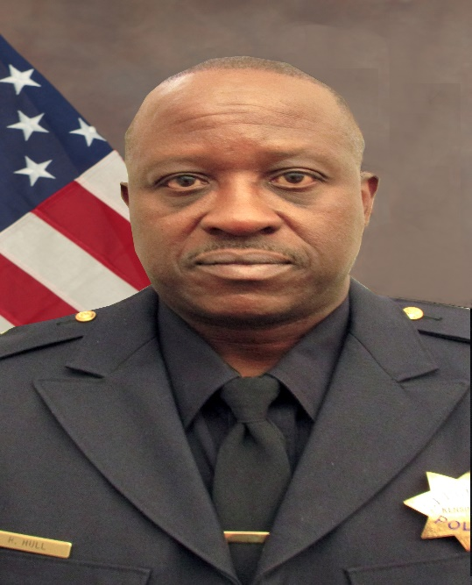
Promotion
Amit was promoted to Police Sergeant on January 4, 2021. He has prior experience with the Richmond Police Department and has done an outstanding job for the Kensington Police Department. He has been instrumental in assisting the Chief of Police in improving the operations of the department. He has received several letters of appreciation and commendations during his career and was recently presented with a leadership award. He has two Associate Degrees in General Education and Electronic Engineering. Amit holds a Bachelor of Science Degree in Criminal Justice and is registering for classes for his Master’s Degree in Administrative Leadership.
Detective Sergeant Amit Nath
Retirement
Rickey officially retired on December 30th, 2020. He was hired in 1997. Prior to working with the KPD, he spent six years in the United States Air Force and was a jailer for the Concord Police Department. During his 23-year career with Kensington PD he held the ranks of Police Officer, Sergeant, Master Sergeant, Interim Chief of Police, and Captain. Rickey has received numerous letters of appreciation throughout his tenure and is well-known in the community. We wish him the best in his retirement!
Captain Rickey Hull

Slide 13
Recognition and Awards
Officer of the Year – Officer Brad Harms
The recipient of this award is nominated by members of the department and submitted to the Chief of Police. The Officer must demonstrate consistent exemplary and sustained performance throughout the year.
Leadership Award - Detective Sergeant Amit Nath
This award is granted to any department staff for exemplary service, dedication, and leadership. It is awarded to those who perform their duties with dedicated professionalism, operational excellence, exhibit zeal in their attitude, inspire enthusiasm in their fellow colleagues, and demonstrate a sense of community awareness.
Chief’s Award
Officer Tamiko Fodor
&
Officer Roy Bang
The Chief’s award is granted by the Chief of Police to an employee who significantly contributes to and assists the Chief of Police in achieving the overall goals and objectives of the Police Department.

Slide 14
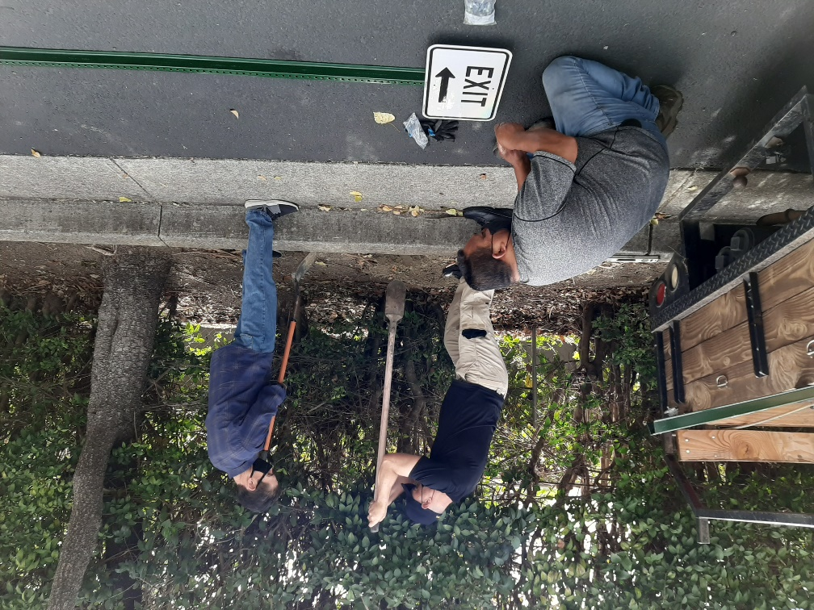
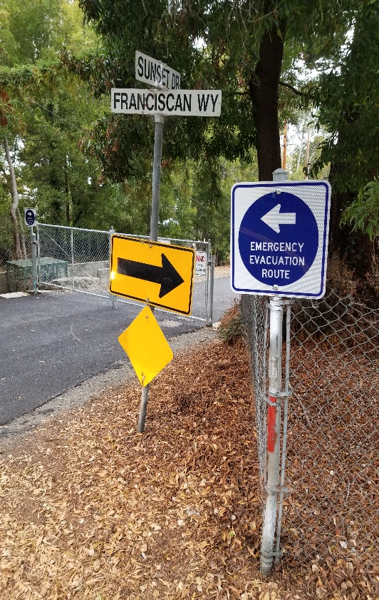
Kensington Evacuation
With the dangers of wildfires in California, Kensington PD is working hard to prepare the District and community. This past year, Officer Brad Harms worked closely with Sunset View Cemetery as part of these preparation efforts.
During an emergency and should an evacuation be necessary, Sunset View Cemetery will provide access to and through the cemetery at Sunset Drive and Franciscan Way offering an additional evacuation route for residents. Adding this evacuation route will reduce traffic congestion by 30% in the event of an emergency.
Interim Chief of Police Schuld, Officer Harms and Sgt. Nath installing
evacuation signs.

Slide 15
2021 GOALS & OBJECTIVES
Develop a formal Community Outreach Plan.
Initiate the process for Kensington PD to become certified through the Commission on Accreditation for Law Enforcement (CALEA).
Initiate a long-term Strategic Planning Process, which will include input from the Community, Board, and Employees.
Improve preparedness and professionalism by increasing training.
Complete a department-wide Team Building Workshop professionally facilitated by P.O.S.T.
Increase the use of technology to improve service delivery
and efficiency.
Institute Succession Planning for future department leadership.

Slide 16


Slide 17


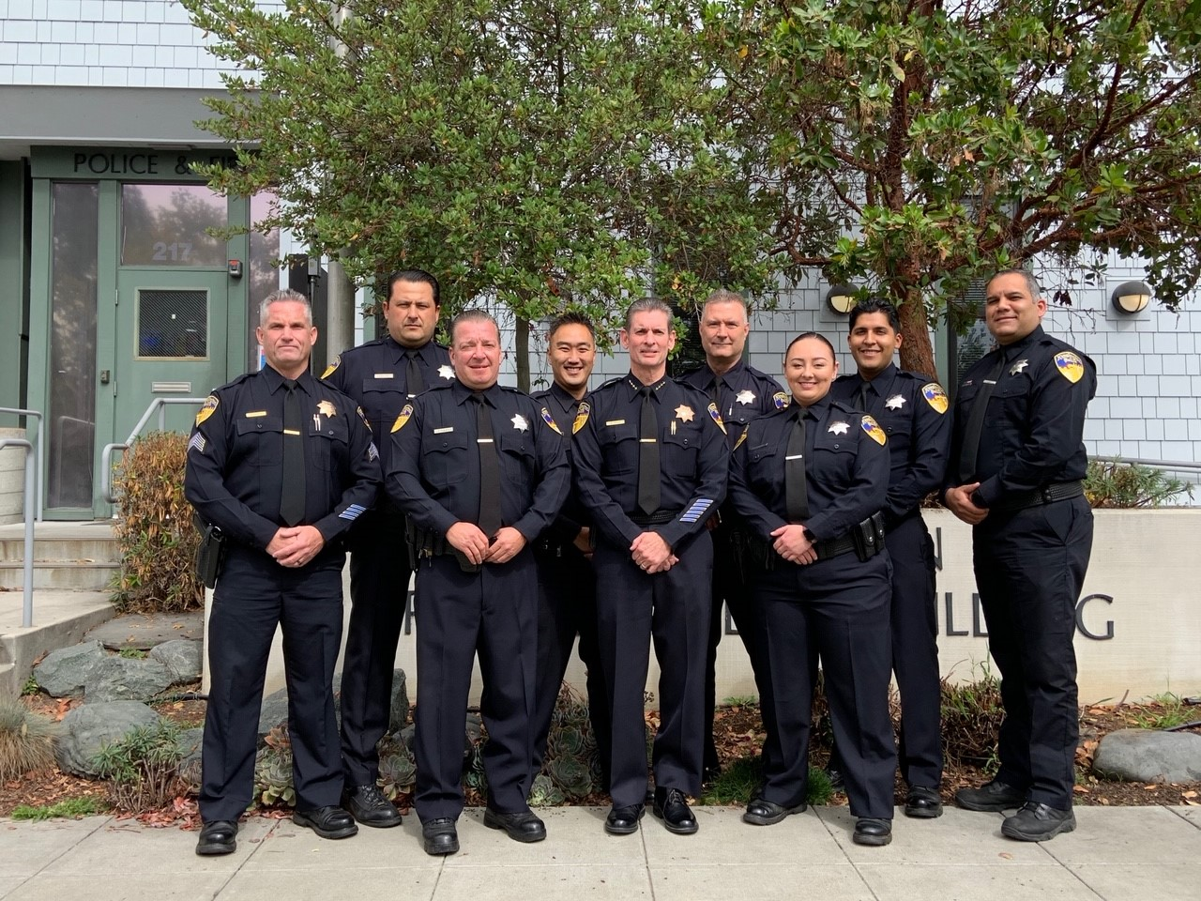
Kensington Police Department
217 Arlington Ave
Kensington, CA 94707
Main Office: (510) 526-4141
Dispatch: (510) 525-7573

