Slide 1
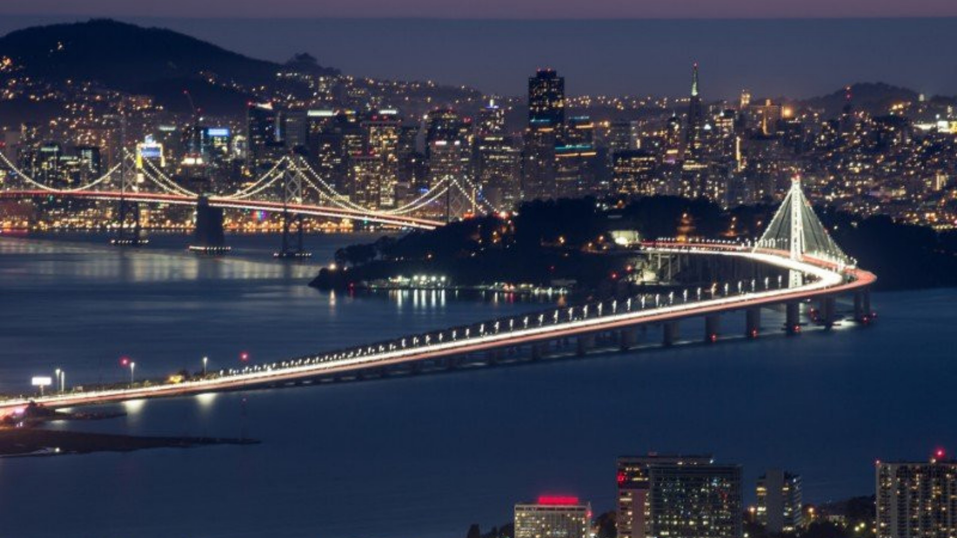

Comprehensive Traffic Safety Program
Kensington Police Department
Making Traffic Safety a Core Value
Notes:
https://unsplash.com/photos/NMIC26XiyIw

Slide 2


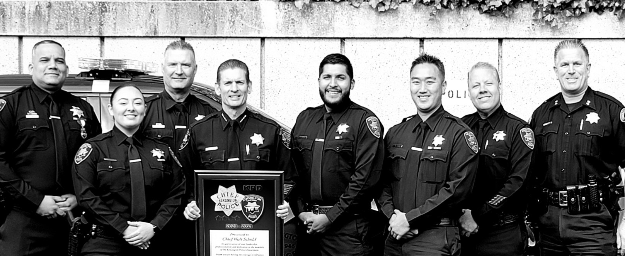


Through a strong commitment to traffic safety, we will ensure positive results now and in the future.
  Employee ownership
  Culture adjustment
Organizational Change
  Must be flexible
  Without compromising the mission
Strategic Planning
Measuring Progress
Reduce Traffic Violations
Reduce Accidents
Make the Roadways Safer
“Making Traffic Safety a Core Value.”
Notes:
https://unsplash.com/photos/HUK8bFXgYkQ

Slide 3
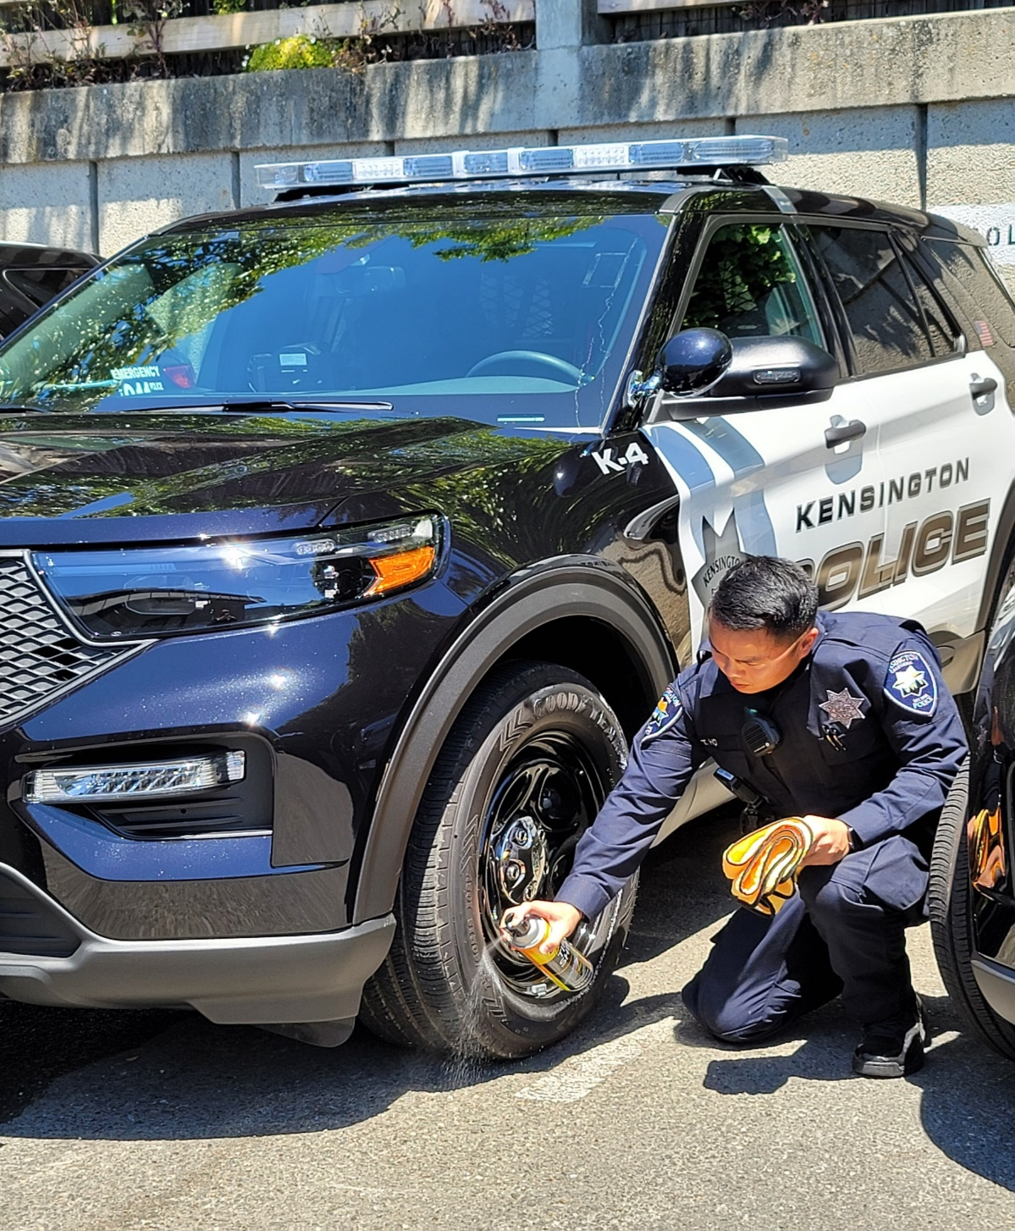

Organizational Priority
Increasing Employee Ownership
Give employees the “why” - Mission
Align values – FTO/Sergeant/Lieutenant
Constant Communication
Collaboration and Process Improvements
Recognition For Work
Organizational Change
“Making Traffic Safety a Core Value.”
Notes:
https://unsplash.com/photos/HUK8bFXgYkQ

Slide 4
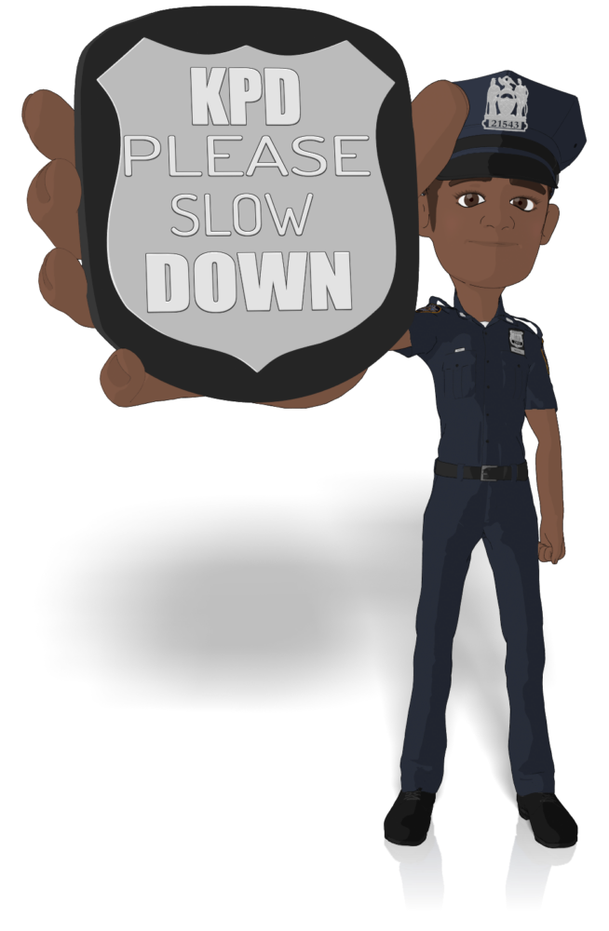
Strategic Planning Process
Strategic Planning
Setting The Stage
  Deploy Traffic Enforcement Car July 1
  Universal Traffic Enforcement Training
  Modern Equipment/Evidence Collection
  Optimized Scheduling For Effectiveness
  10 hours/day deployment of TSU
  Goals
  Public Safety
  Educational Campaign (Variety)
“Making Traffic Safety a Core Value.”
Notes:
https://unsplash.com/photos/HUK8bFXgYkQ

Slide 5


How Are We Doing?
Measuring Up
  Supervisor to Review All Citations
  Supervisor to Submit Weekly Report
  Employees to Report Daily Activity
  Monthly Reporting
  End of Year Reporting
Evaluate Progress
“Making Traffic Safety a Core Value.”
Notes:
https://unsplash.com/photos/HUK8bFXgYkQ

Slide 6




Keys to Success 2021
Traffic Safety throughout all operations of the department (e.g., Traffic Safety Unit).
Ensure adequate training, equipment, and staff are ready to fulfill the
responsibility of providing traffic safety.
Seek agreement with labor on the importance of including traffic-related items in promotional processes.
Integrate
Training
Creative
Community
Positive educational campaign, community outreach, and innovative technology (e.g., Office of Traffic Safety).
.
.
Notes:
https://unsplash.com/photos/HUK8bFXgYkQ

Slide 7

Questions & Discussion
Notes:
https://unsplash.com/photos/HUK8bFXgYkQ

