Slide 1
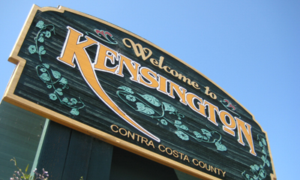
Police Services Analysis – Community Meeting 2
Kensington Police Protection and Community Services District, California

Slide 2
Purpose of the Meeting
To bring clarity to the scope of work and goals of the study.
To report on the feedback received from the community over the past month – survey responses, emails and the previous public meeting.
To provide the preliminary findings on the study of Kensington’s existing police services.
To get community input on the framework for the feasibility phase of the project.
A lot to get accomplished in two hours!
Overview of the agenda and format for today’s meeting.

Slide 3
Scope and Status of the Study
There are two basic goals of the study:
  An understanding of the unique values and needs of Kensington residents – from their policing agency.
  Evaluation and development of the options that best meet Kensington’s policing needs.
There are 3 basic options – the current model (in house), contracting (a partnership) and a hybrid.
This is an independent and objective assessment of police services.
We are still in the early phase of this project, completing the assessment of the existing police services.
This is a common ‘good government approach’.
The majority of similar studies ended with a new commitment to an improved in house model – with a new road map to get better.

Slide 4
Public Input – Last Meeting’s Highest Priority Policing Goals
Adequate staffing
Better traffic enforcement
Better training for officers
High levels of professionalism in the Department
Maintaining a high quality police force
Need for adequate funding for police services regardless of the options
Rapid response times
School and child safety

Slide 5
Results of Public Input – Survey
The community survey was designed to obtain input on current police services and what is important to the community.
The survey was a substitute for conducting interviews of the public.
It was not scientific; it was not a vote.
Moreover, it did not ask for views on contracting for service.
Over 625 people responded!
  There were only 26 devices that has multiple responses resulting in few additional surveys (only 2 were greater than 5 responses).
  There were no completely duplicated responses
We feel confident that the survey gave us important feedback.
In addition, we have received phone calls and hundreds of emails from residents.

Slide 6
Results of Public Input – Survey
Most people feel safe in Kensington – 98%!
Concerns were expressed about several issues in the community:
  Property crimes were most often mentioned
  Other issues included traffic, drugs and ‘quality of life’ issues
Most respondents (75%) had contact with KPD in the past 2 years.
  54% of respondents had requested a police unit
  29% had attended a police / community meeting
  Most of these interactions were positive (85%)
Most respondents had positive views regarding:
  Responsiveness (78%)
  Proactivity (55%)

Slide 7
Survey Results – Police Contacts

Slide 8
Preliminary Results of the Analysis of Kensington’s Police Services (1)
This portion of the study was conducted through staff interviews and data collection.
There are many positive aspects of Kensington’s current police services:
  Kensington is a safe community as defined by crime levels – it is within the top 7% of safe communities in California.
  Residents feel safe as evident in these meetings and the survey.
  Kensington generates very few requests for a police response – only about 4 community generated calls per day.
  As a result, officers have extensive opportunities to deal with problems proactively.

Slide 9
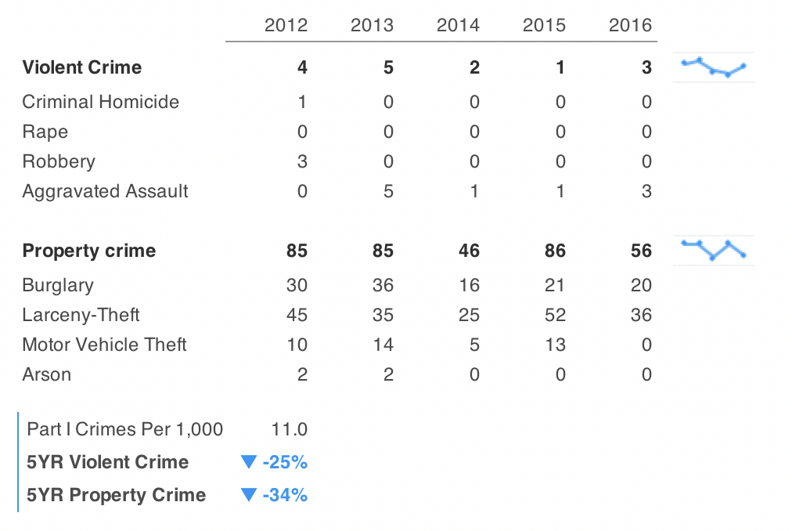
Major Crime in Kensington

Slide 10
Preliminary Results of the Analysis of Kensington’s Police Services (2)
There are also issues with Kensington’s current police services:
  Kensington’s response times are higher than expected, though, the most calls are not serious and roads and topography are factors.
  Kensington police officers do not use the high levels of proactive time to do proactive things (only about 4 activities per day).
  Kensington suffers from chronic shortages of staffing:
    Recently as few as 5 – 6 of the 10 authorized
    Many hours per week (168 hours) have only 1 officer deployed
    There are no supervisors on late nights or weekends
    Recruitment and retention are major issues (13% turnover average)
  Training and equipment are not at levels for an effective department
  Compensation is significantly lower than neighbors
  Management and leadership have been lacking

Slide 11
Staffing Trends

Slide 12
Response Times

Slide 13
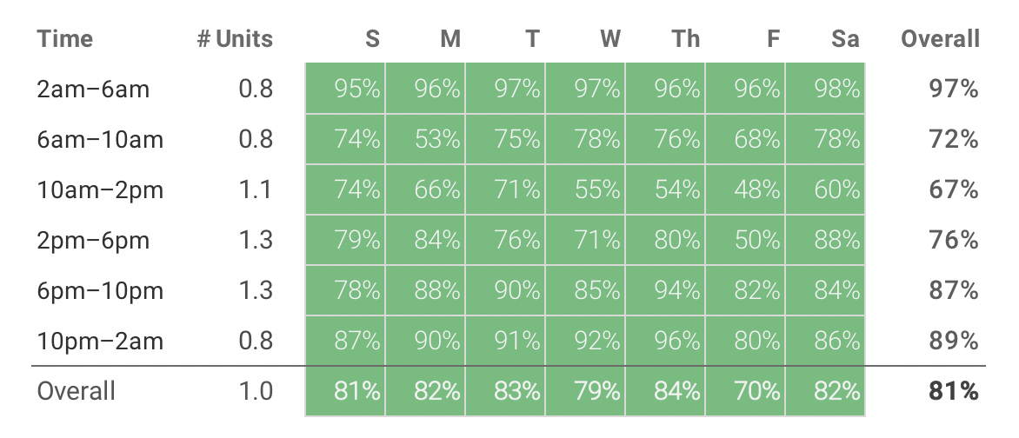
Proactive Abilities

Slide 14
Use of Proactive Time

Slide 15
What Are the Defining Features of an Effective Police Service?
There are many measures used to define and evaluate effective police services.
The President’s Task Force on 21st Century Policing (2016) provides a widely accepted set of defining principles:
  Building trust and legitimacy
  Policy and oversight
  Community policing and crime reduction
  Training and education
  Technology and social media
  Officer safety and wellness
Cost and the community’s ability to pay is also a consideration.
These principles can be used to target areas of improvement for Kensington’s police services in any scenario.

Slide 16
Preliminary Evaluation for Kensington’s Police Services (1)
The District needs 2 on duty at all times – this requires, at a minimum, at least 10 officers plus a Chief.
One on duty needs always to be a supervisor.
Full time resources augmented by the continued use of reserves
Develop a community volunteer program to assist in administration and consider implementing a ‘community volunteers’ program
To achieve this a number of other things need to be in place:
  Competitive compensation and benefits
  An effective training program targeting at least 40 hours per year
  Better equip officers (e.g., body worn cameras)
  Recruit officers who would be interested in ‘small town policing’

Slide 17
Preliminary Evaluation for Kensington’s Police Services (2)
Retain a full time experienced chief.
Even if a Kensington Department is retained explore more cooperative relationships with neighboring departments.
The Chief, General Manager, Board and the community develop a strategic plan for the Department.
As part of this plan, develop an approach for appropriate Department oversight with appropriate roles for the Board, General Manager and the Chief.
Develop an effective performance reporting system for the General Manager, the Board and the public.
To assist in department support, a full time administrative assistant needs to be retained.

Slide 18
Evaluation Criteria for the Selection of Alternatives?
Adjacent community?
Dedicated Kensington beats?
Dedicated Kensington officers?
Dedicated leadership?
Depth of services?
Accountability?
Costs?
Other factors?

